Slide 1
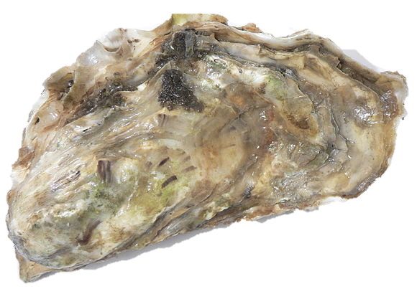

The genetic legacy of the deliberate introduction of Pacific oysters
Erik Sotka
Allan Strand
Ryan Carnegie, Jim Carlton, Lucia Couceiro, Jeff Crooks, Hikaru Endo, Hilary Heyford, Masakazu Hori, Mits Kamiya, Gen Kanaya, Judith Kochmann, Kun-Seop Lee, Lauren Lees, Hannah Miller, Massa Nakaoka, Eric Pante, Jennifer Ruesink, Evangelina Schwindt, Åsa Strand, Richard Taylor, Ryuta Terada, Martin Thiel, Takefumi Yorisue, Danielle Zacherl

Slide 2
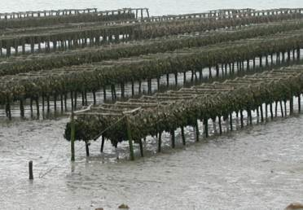
Crassostrea (Magallana) gigas Pacific cupped oyster
Among the most important aquacultural shellfish worldwide
C. gigas aquaculture
- $1.2 Billion per year
- 644,000 tons per year

Slide 3
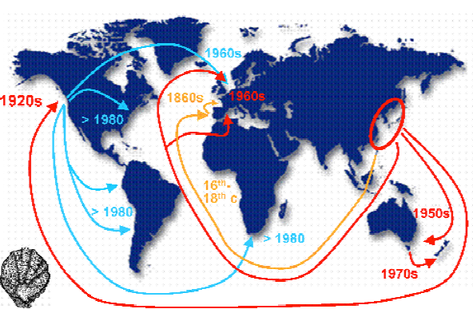
Crassostrea (Magallana) gigas Pacific cupped oyster
Among the most important aquacultural shellfish worldwide
Deliberately introduced to five continents for at least 150 years
Troost 2010

Slide 4
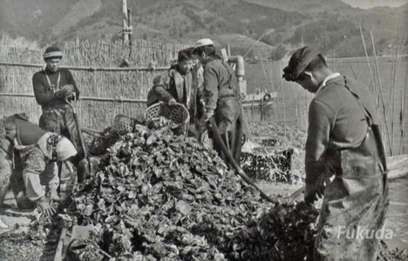
Crassostrea (Magallana) gigas Pacific cupped oyster
Among the most important aquacultural shellfish worldwide
Deliberately introduced to five continents for at least 150 years
The second most frequent vector for the transport of nonnative marine and estuarine species worldwide*
Professor Yasuyuki Koike
Oyster World Congress 2012
*Naylor et al., 2001, Ruiz et al. 2015, Ruesink et al. 2000

Slide 5
Genetic legacy of Pacific oyster introductions
Population genetic structure of native Pacific oysters (China, Korea, Japan)
The invasion history of non-native populations (USA, Europe, NZ, South America)
Signatures of Pacific oysters on putatively co-introduced species (algae and invertebrates)

Slide 6
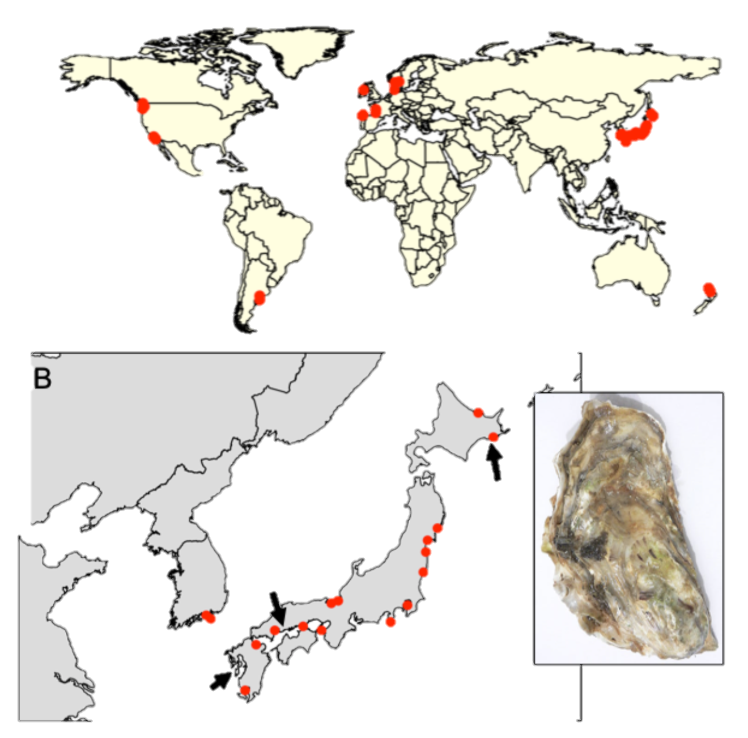
Sampling design
41 populations (n ~ 20)
20 native
21 non-native
Feral populations (on rocks, jetties, reefs, etc..)
Genotype-by-sequencing
Dataset: 726 individuals from 7046 loci (no missing data and at HWE)
Hokkaido
Miyagi
Hiroshima
Kumamoto
Notes:
Kumamoto C. sikamea oyster

Slide 7
Genetic legacy of Pacific oyster introductions
Population genetic structure of native Pacific oysters (China, Korea, Japan)
The invasion history of non-native populations (USA, Europe, NZ, South America)
Signatures of Pacific oysters on putatively co-introduced species (algae and invertebrates)

Slide 8
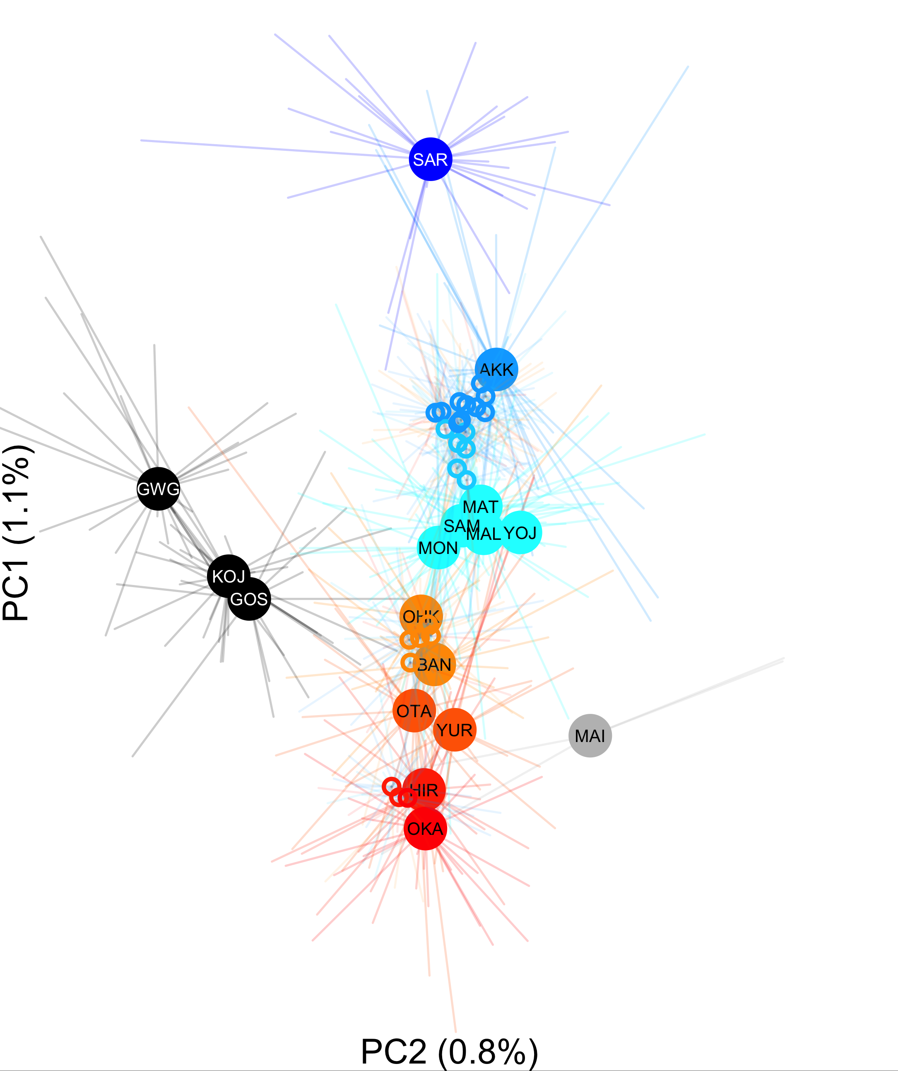
Genetic differentiation along latitude in Japan Phi_{st} = 0 to 0.011
Hokkaido
Miyagi
Hiroshima

Slide 9
Genetic legacy of Pacific oyster introductions
Population genetic structure of native Pacific oysters (China, Korea, Japan)
The invasion history of non-native populations (USA, Europe, NZ, South America)
Signatures of Pacific oysters on putatively co-introduced species (algae and invertebrates)

Slide 10
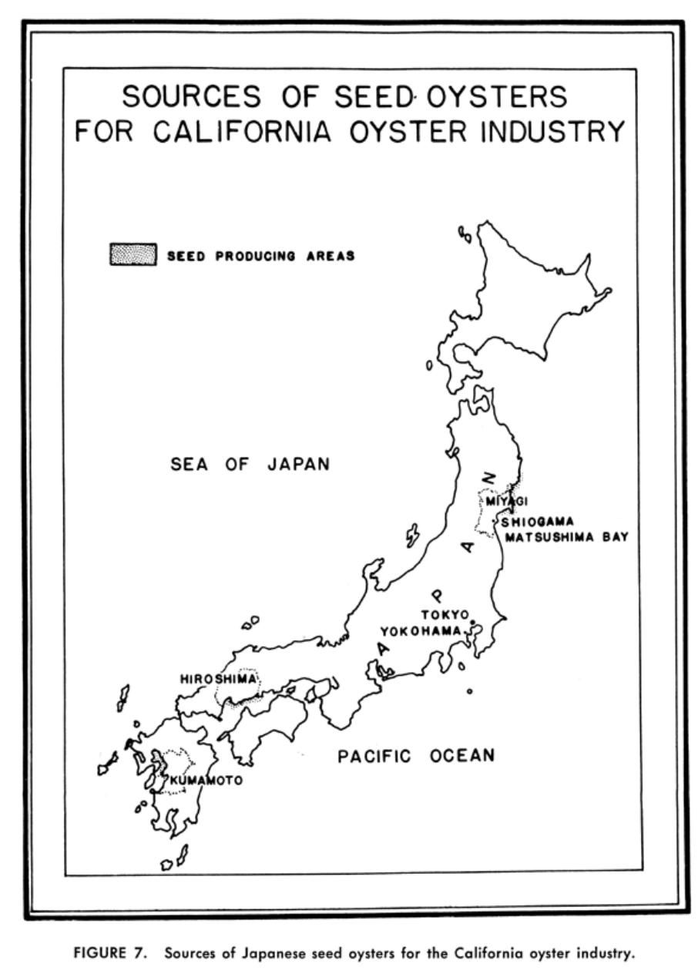
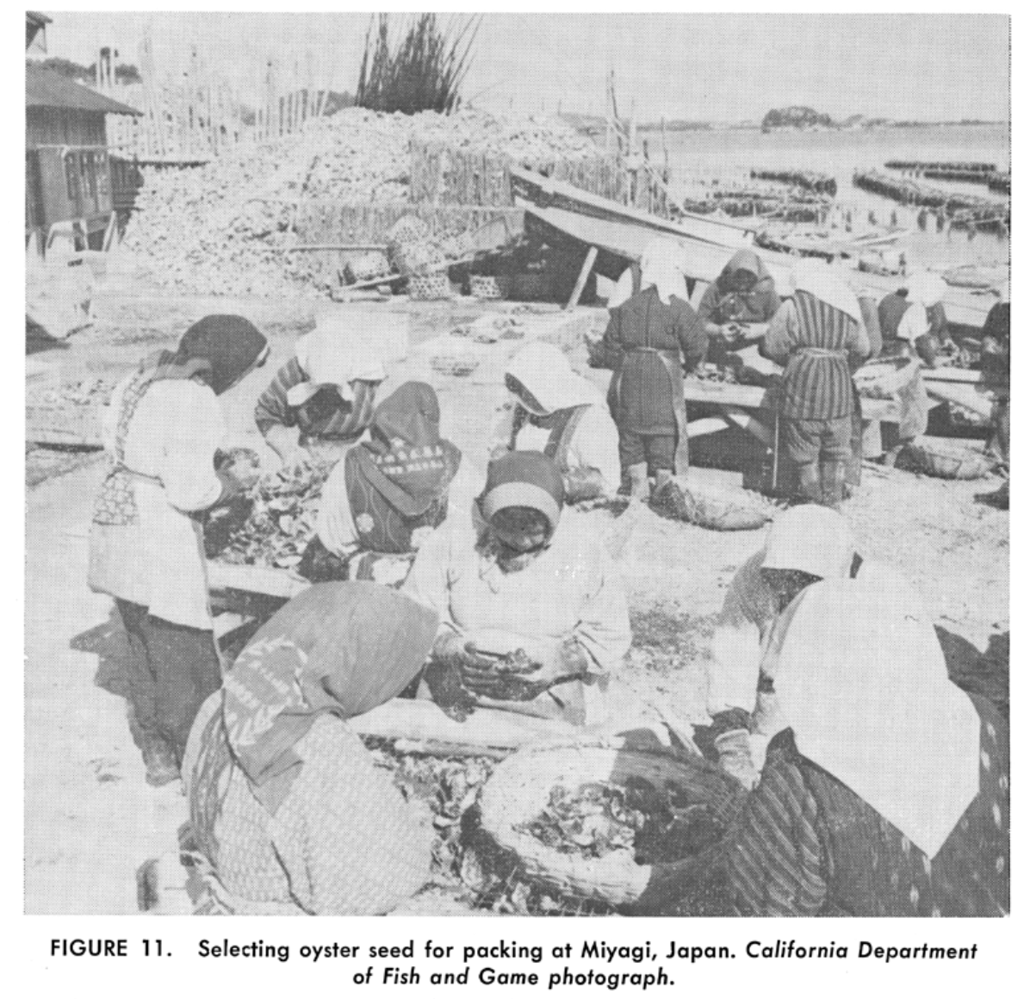
Barrett 1963

Slide 11
Genetic differentiation among non-native populations
colors based on Genetic PC1

Slide 12
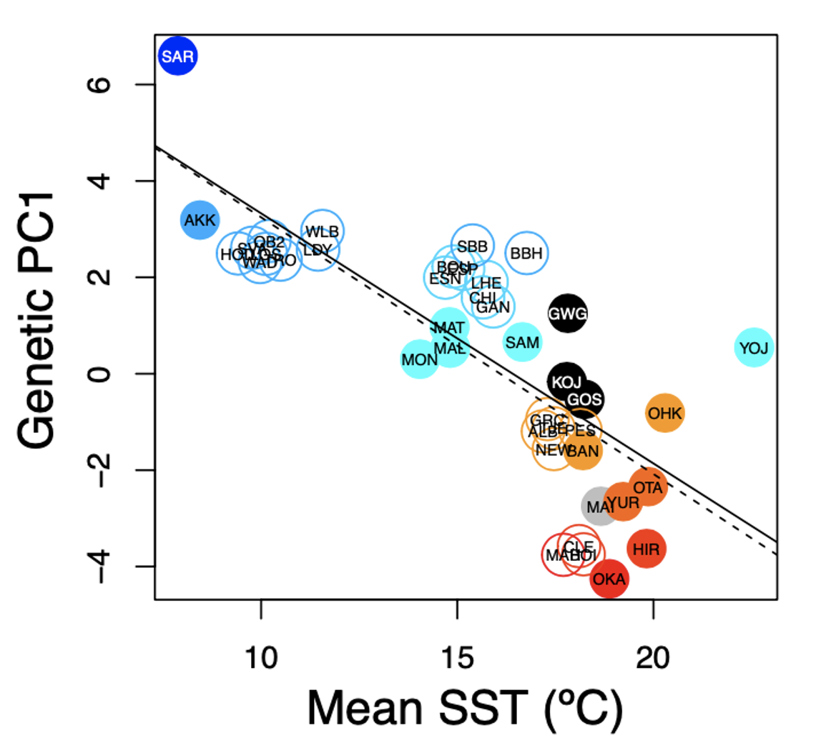
“Deliberate” ecological fitting during introductions
Native: r² = -0.777; p< 0.001
Introduced r² = -0.744; p< 0.001

Slide 13
Genetic legacy of Pacific oyster introductions
Population genetic structure of native Pacific oysters (China, Korea, Japan)
The invasion history of non-native populations (USA, Europe, NZ, South America)
Signatures of Pacific oysters on putatively co-introduced species (algae and invertebrates)

Slide 14
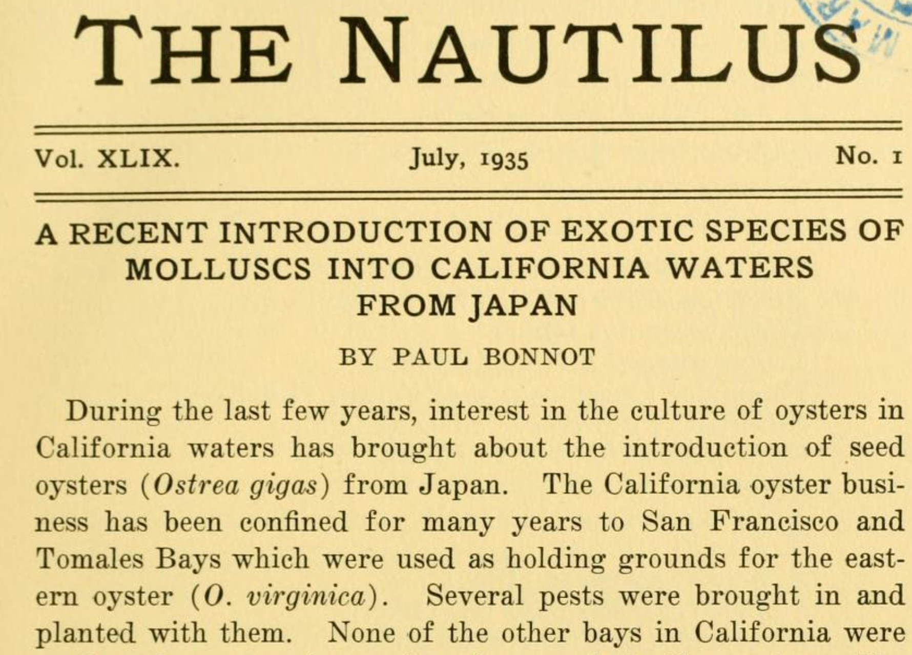

Slide 15
The greatest agency of all that spreads marine animals to new quarters of the world must be the business of oyster culture, a very ancient and world-wide craft. – Charles Elton (1958)

Slide 16
Bonnot (1935) documented the occurrence of invasive mollusks with imported Japanese oyster shipments to North American estuaries.
From ad hoc reviewers of K-H 2017 at Mol Ecol
Furthermore, their claims to identify the vector (C. gigas) remains purely speculative - this would be confirmed by congruent patterns of genetic diversity of both C. gigas and G. vermiculophylla in their native and introduced ranges.
"... our results support anecdotal evidence that oysters were the key vector for the G. vermiculophylla invasion." Congruent patterns of genetic diversity across the two species would have clarified this - as it is, there is only "arm-waving".
All in all, there is not conclusive evidence in the manuscript to convince the reader about the role of C. gigas as a vector beside the coincidental presence in the northern hemisphere. A comparison between the genetic structure of the vector and of the alga could have been attempted.
“Because this area historically served as the principal source for oyster exports worldwide, we suggest that oysters were the key vector for the G. vermiculophylla invasion. “ Krueger-Hadfield et al 2017 Ecology and Evolution
“The source region historically provided seed oysters (Crassostrea gigas) for aquaculture in North America” Miura et al. 2001 PNAS

Slide 17
Pacific oysters from Europe and Canada, Washington state came from northern Japan
Circlize plots; Machine learning

Slide 18
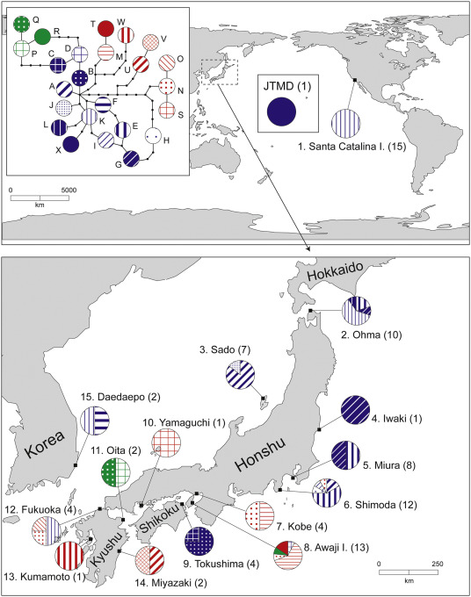

Slide 19
Pacific oysters from southern California are a mix of northern and southern Japan
Pacific oysters from New Zealand came from southern Japan
Circlize plots; Machine learning

Slide 20
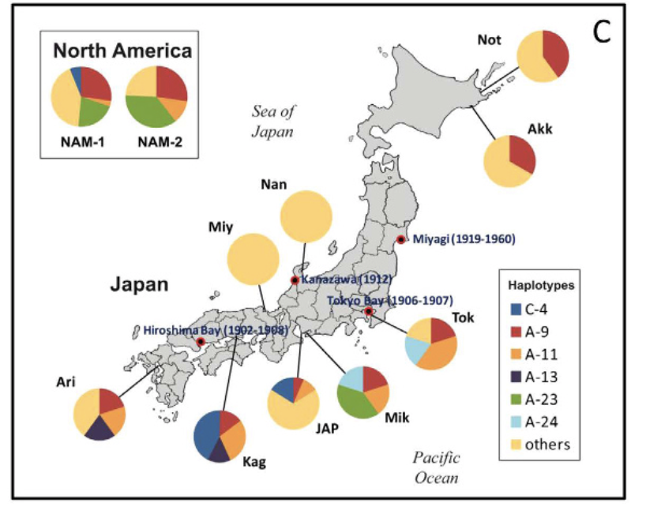
Notes:
Ruditapes

Slide 21
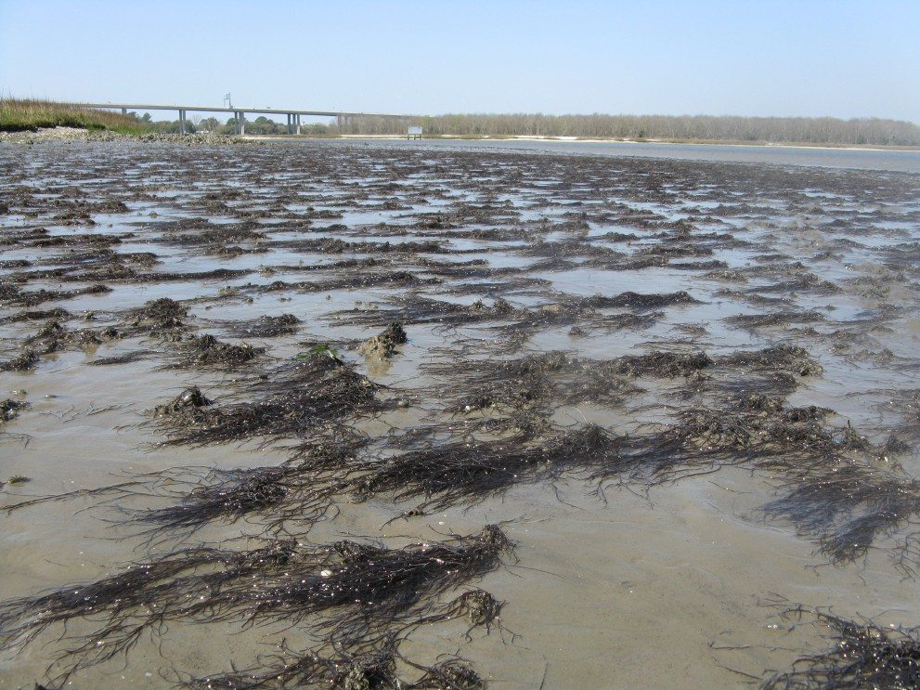
Gracilaria vermiculophylla

Slide 22
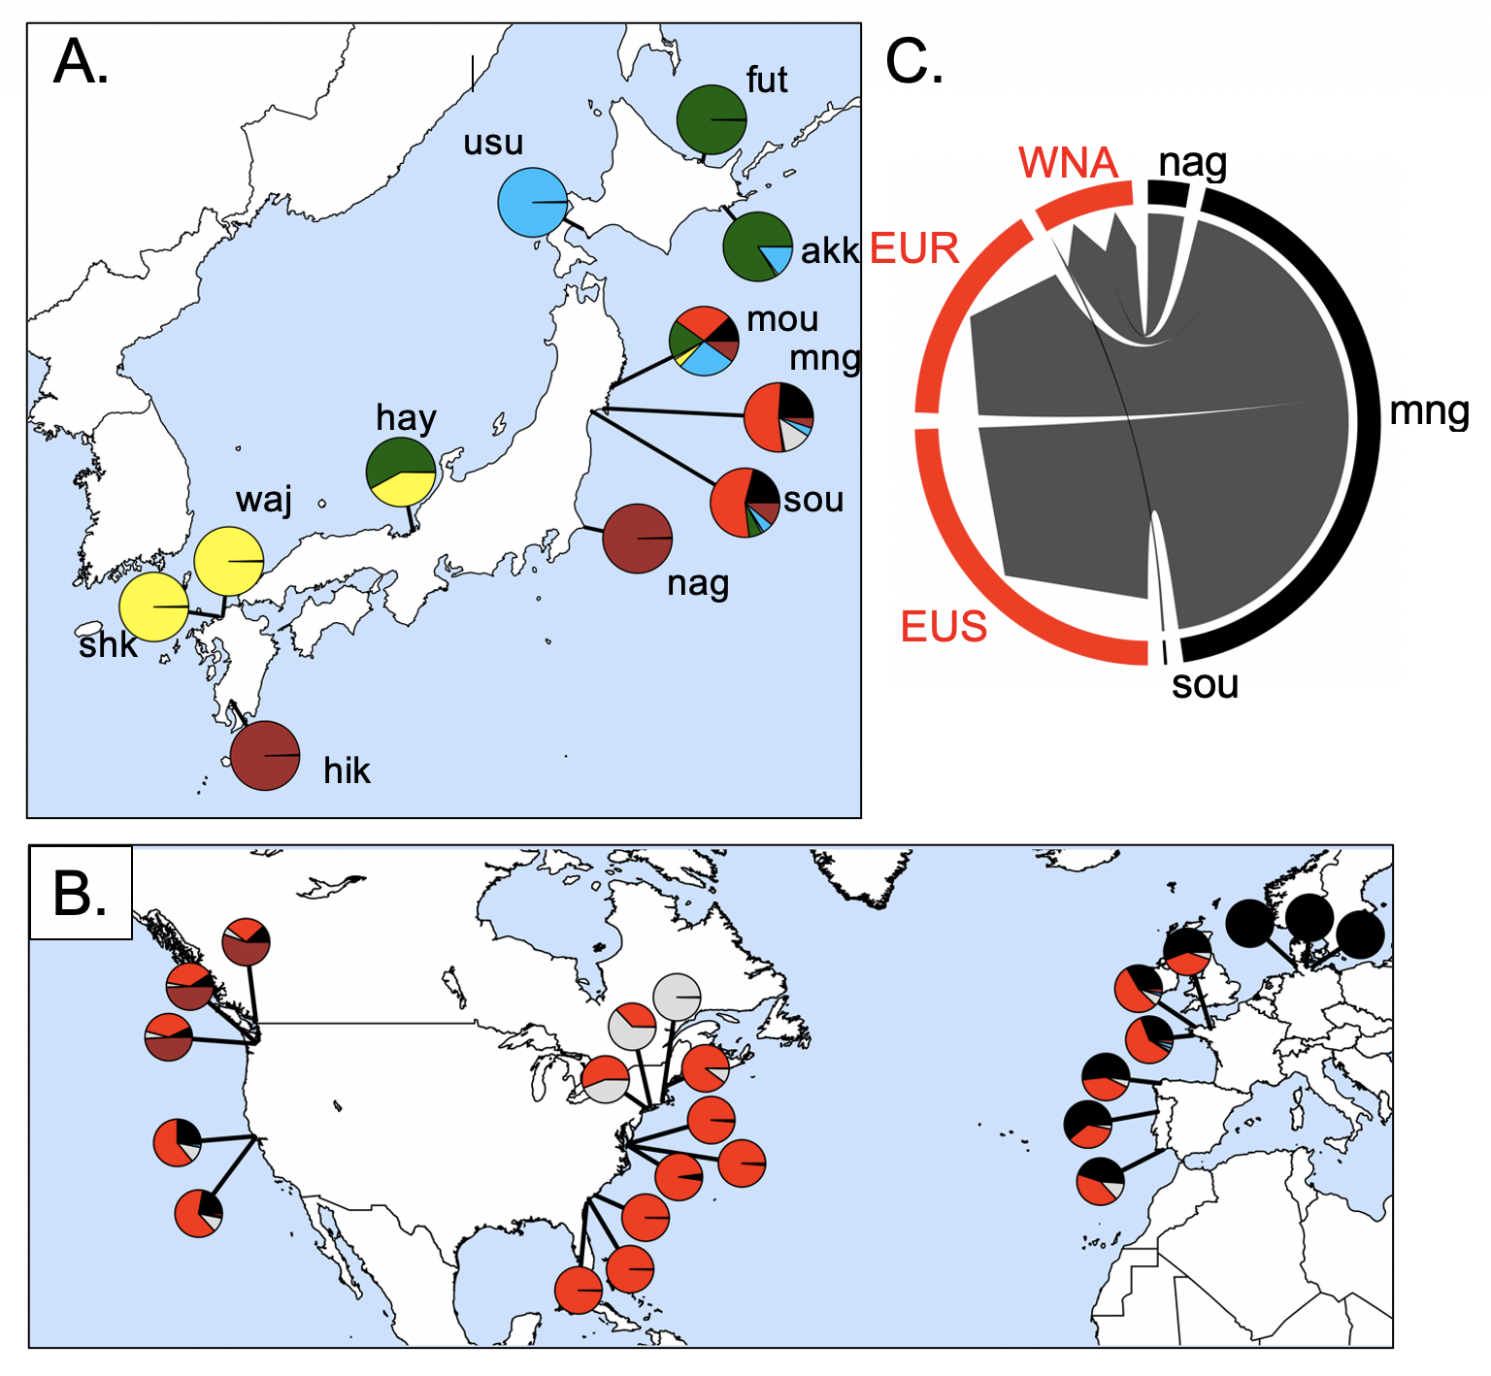
Source of the invasion is northeastern Japan
62,235 SNPs
32 populations
Admixture analysis
Flanagan, Krueger-Hadfield, Murren, Nice, Strand and Sotka (in press) Molecular Ecology

Slide 23
Results (so far)
We can trace genetic history of feral Crassostrea gigas back to native sources
Northern Japan was source for NW North America, southern Europe
Southern Japan source for California and New Zealand
Strange “hybrid” / inbred line / Sea of Japan lineage is found in South America and northern Europe
The environment of native sources predicts local non-native environments.
This suggests either ecological fitting or strain dispersal (or others?)

Slide 24
We note that our approach is to collect feral populations today to infer neutral dispersal patterns that occurred in the past; thus, our interpretations of geographic patterns must keep this limitation in mind. For example, concluding that Pacific Northwest individuals came from northern Japan and southern California from southern Japan may indicate a) the historical record is incorrect or b) the historical record is correct, oysters arrived from all over Japan, but a subset of genotypes created feral populations that survive today.

Slide 25
Argentina | Evangelina Schwindt
Chile | Martin Thiel, Jim Carlton
Denmark | Asa Strand
France | Eric Pante
Ireland | Asa Strand, Judith Kochmann
Japan | Takefumi Yorisue, Masahiro Nakaoka, Mits Kanaya, Masahiro Hori, Gen Kanaya, Ryuta Terada, Hikaru Endo
Korea | Kun-Seop Lee
New Zealand | Richard Taylor
Norway | Asa Strand
USA | Jennifer Ruesink, Hilary Heyford, Danielle Zacherl, Jeff Crooks
Spain | Lucia Couceiro
Sweden | Asa Strand, Judith Kochmann

Slide 27
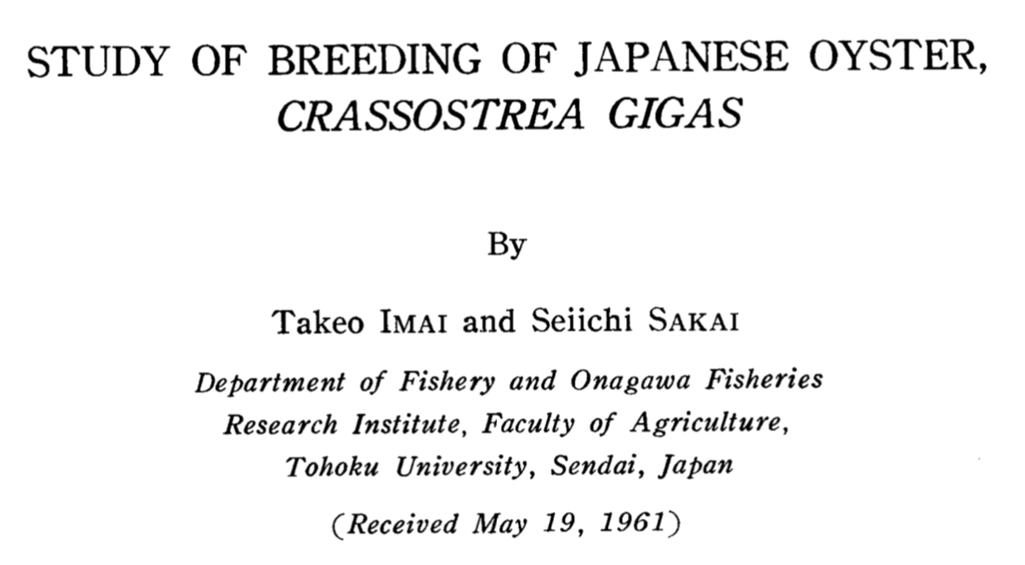
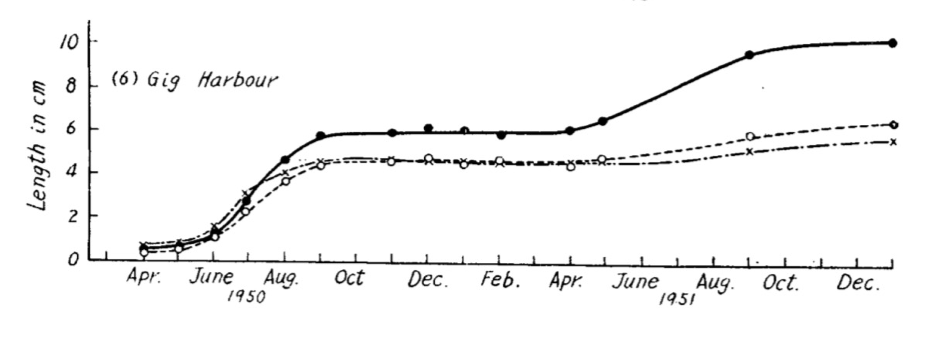
Northern Japan oysters (38% mortality)
Southern Japan oysters (74% mortality)
Northern (44ºN) Japanese oysters had greater fitness in Puget Sound WA (47ºN) relative to Southern (33ºN) Japanese oysters
Northern Japan
Southern Japan

Slide 28
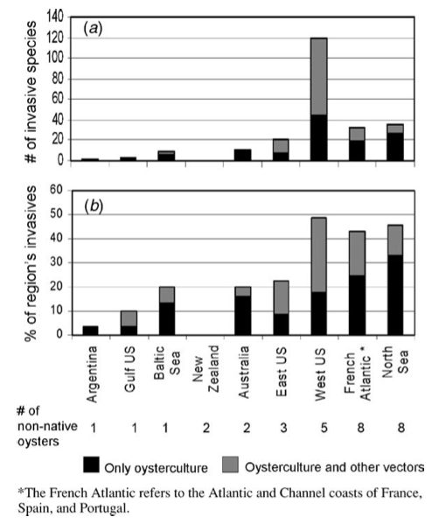
Dozens of species that moved with C. gigas
Ruesink et al. 2005 ARES

Slide 29
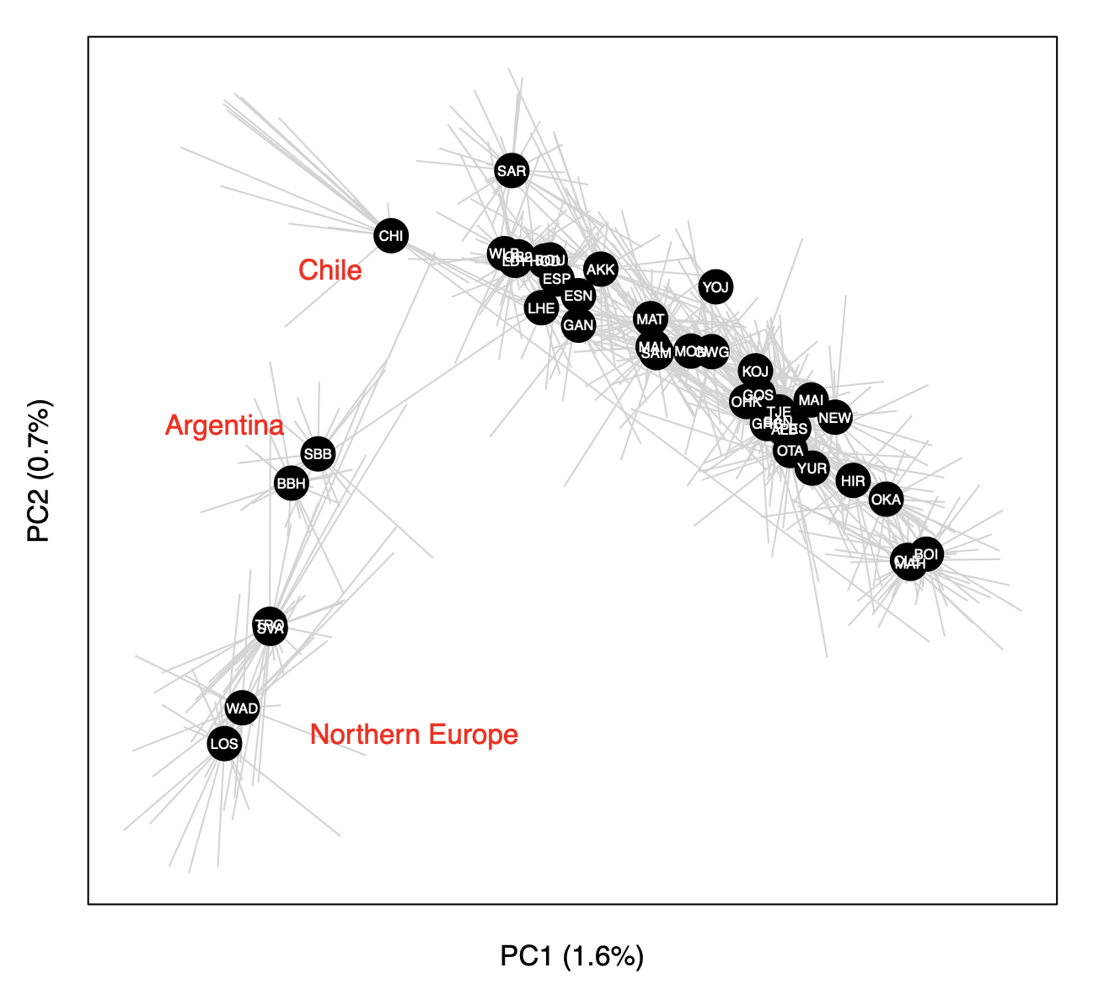
Principal components analysis (PCA) of 726 oysters using 7046 loci

Slide 30
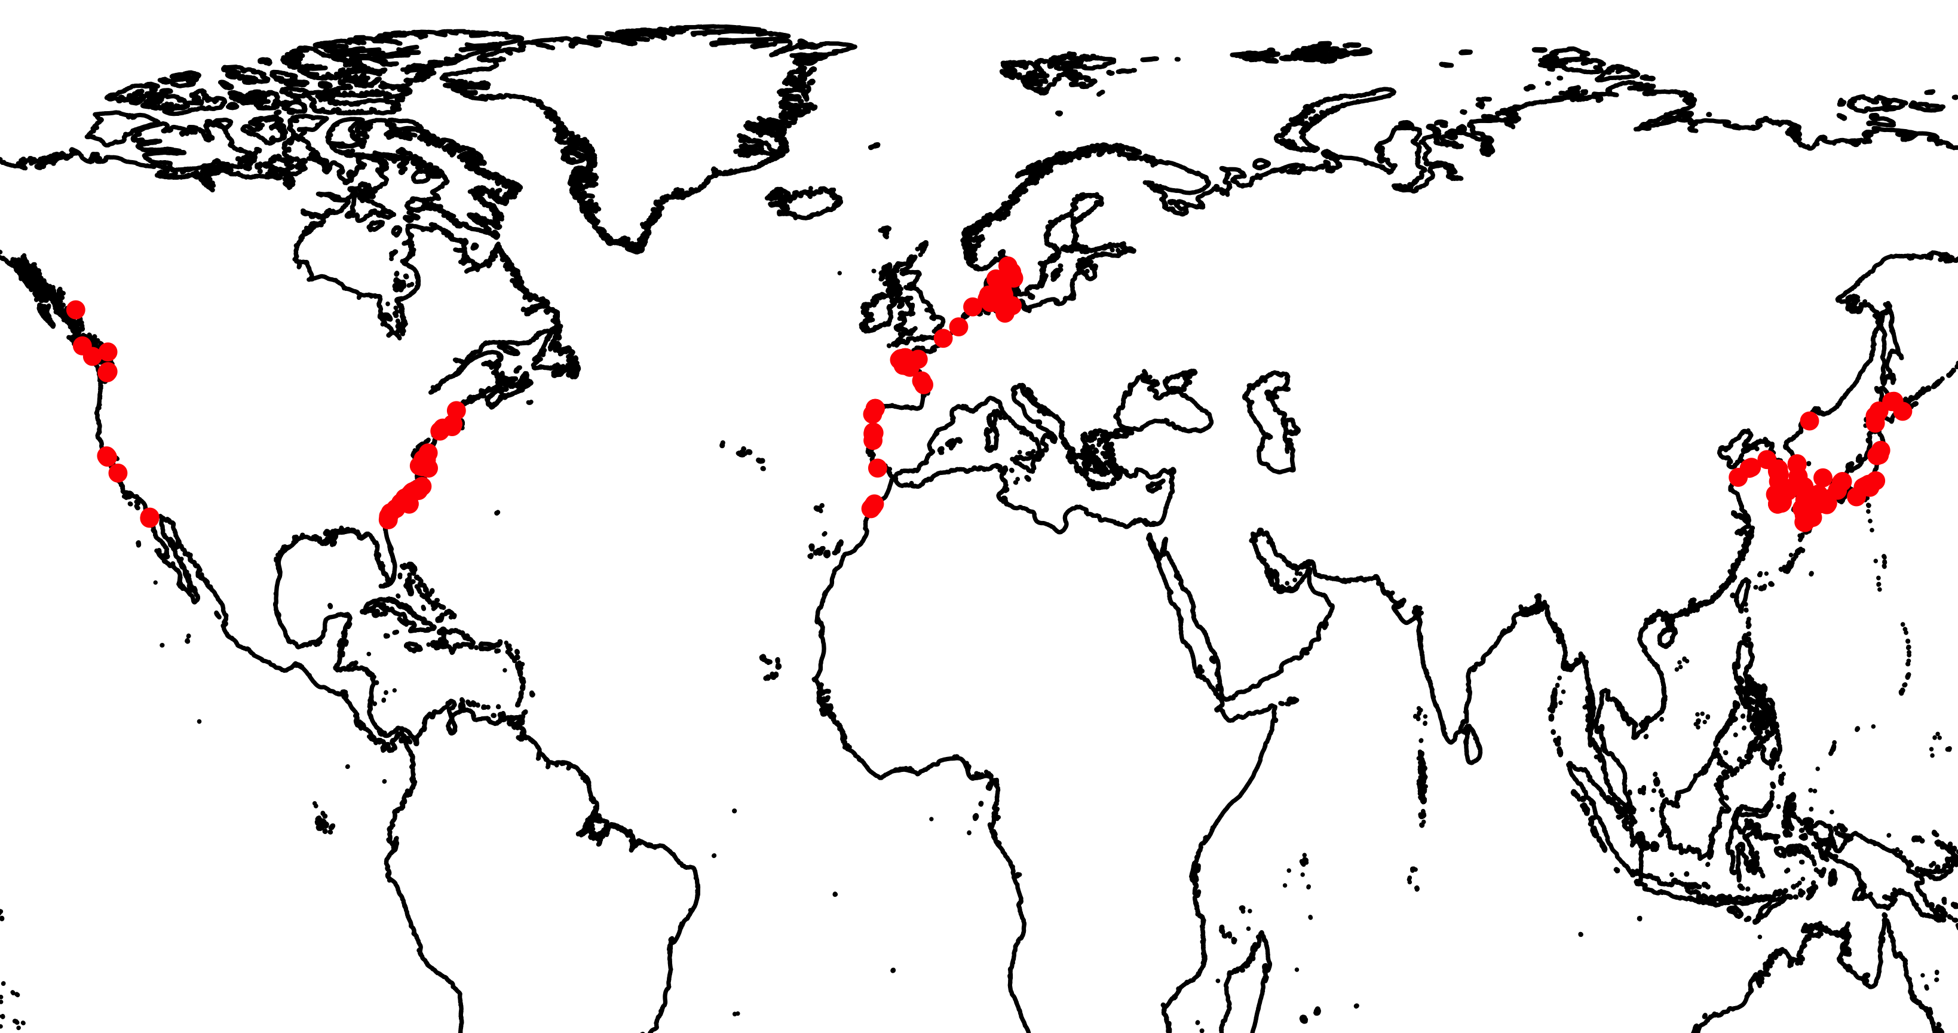
G. vermiculophylla distribution
Introduced: Europe
Introduced: North America
Native

Slide 31
Source of the invasion is northeastern Japan
Annual Sea Surface
Temperature (ºC)
Flanagan, Krueger-Hadfield, Murren, Nice, Strand and Sotka (in press) Molecular Ecology

Slide 32
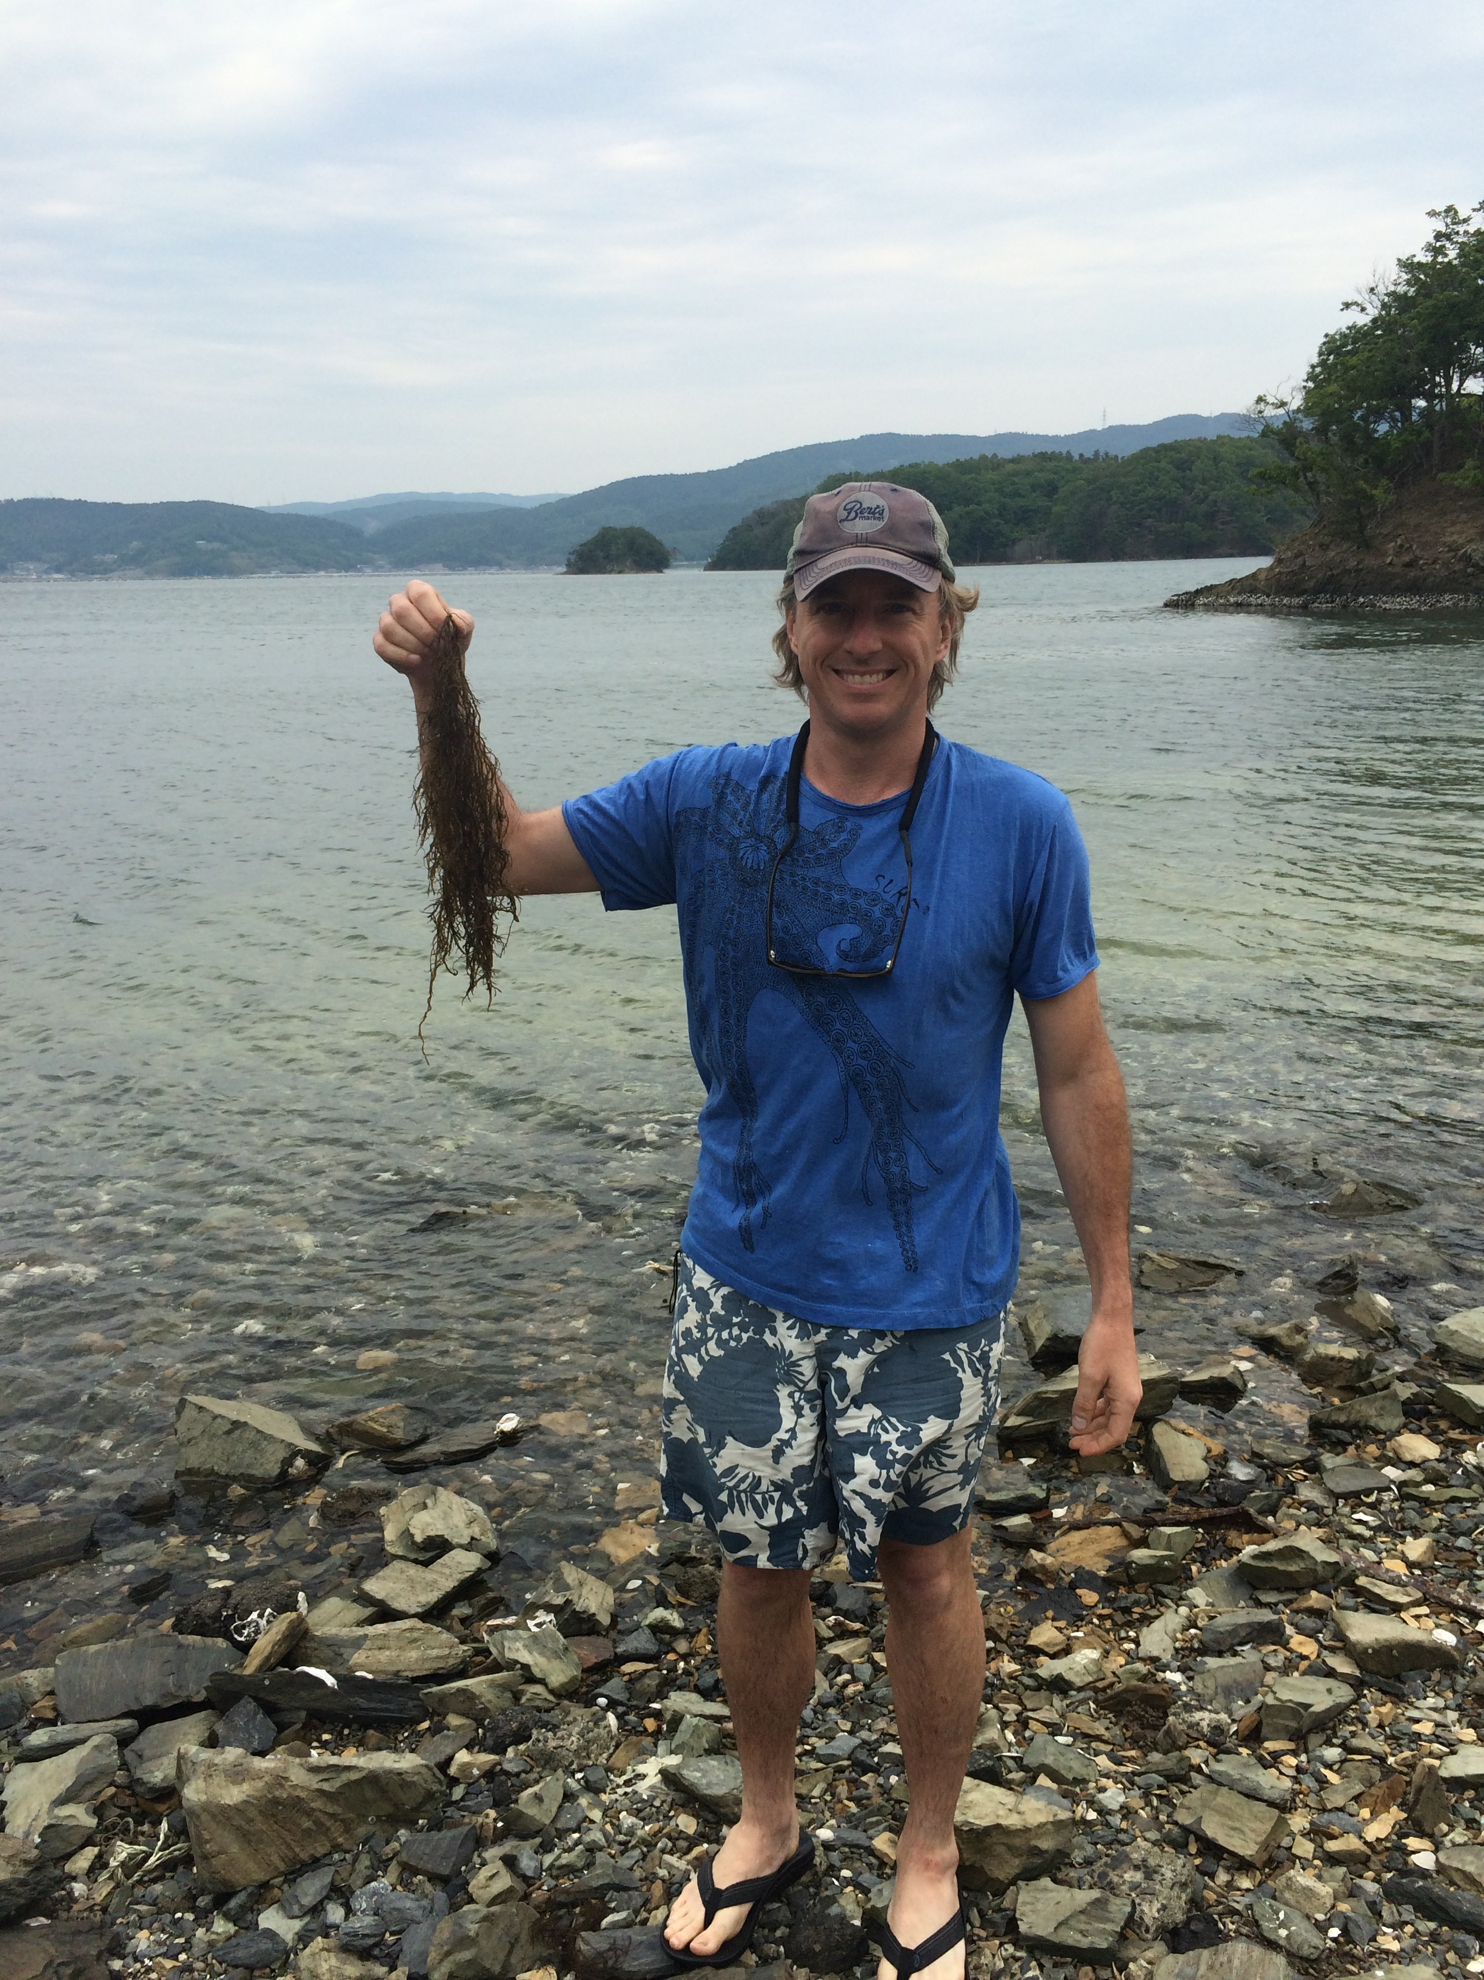
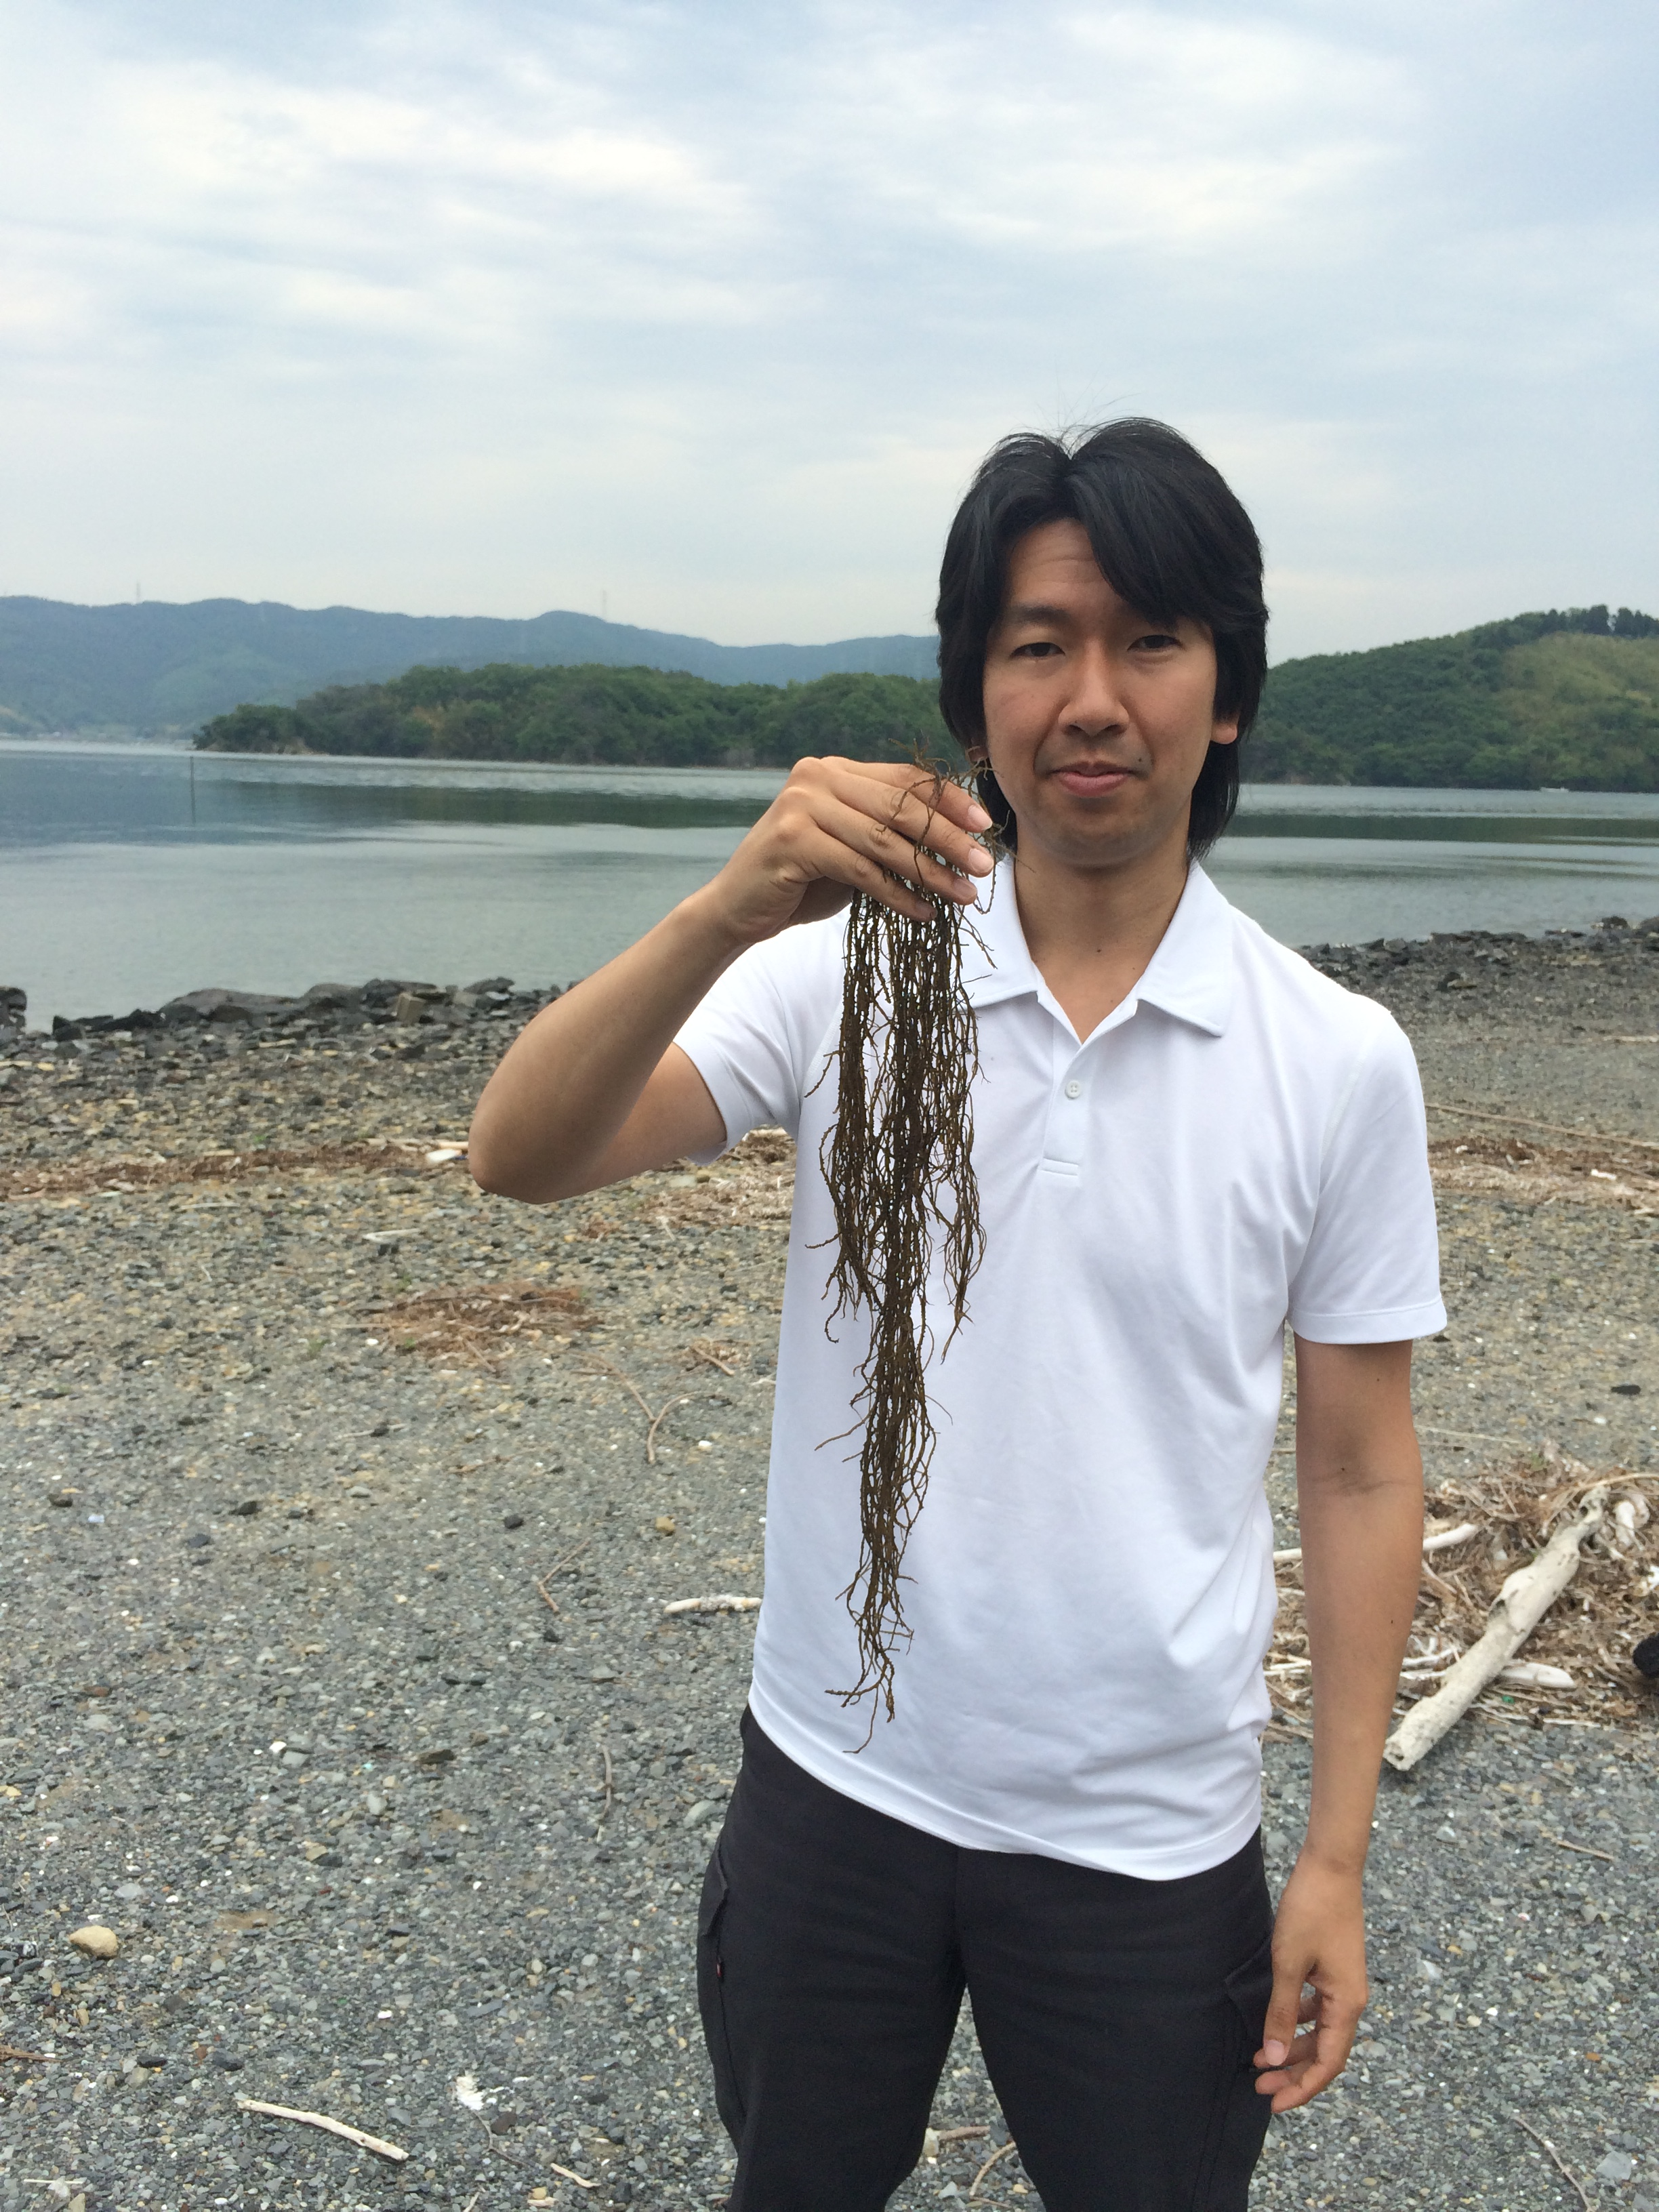
Mangoku-ura, Japan
May 2015

